Slide 1
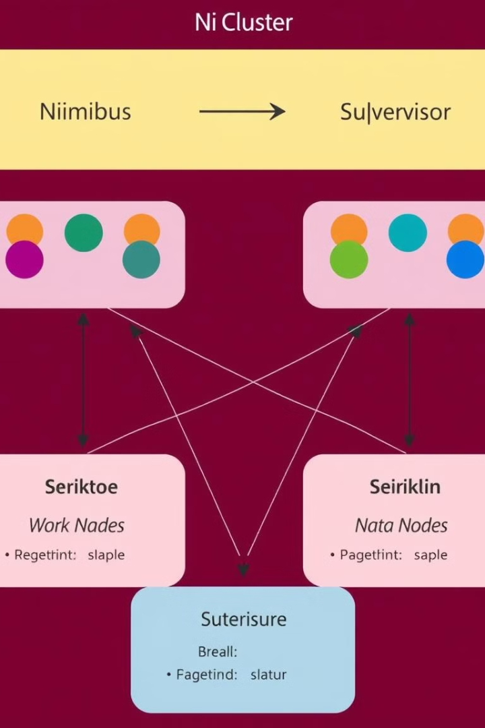
Apache Storm: A Deep Dive into Cluster Architecture
Apache Storm is a distributed, real-time computation system that allows for the continuous processing of data streams. It is designed to handle high volumes of data and operate with high reliability. Storm clusters are made up of various components that work together to execute tasks and process data streams efficiently.

Slide 2
Key Components of a Storm Cluster
Nimbus
Supervisor
Worker Nodes
The central coordinator of the cluster, responsible for submitting topologies and assigning tasks to worker nodes.
Manages worker processes on each node, starting and stopping workers and monitoring their health.
Execute tasks assigned by Nimbus, processing data streams according to the defined topology.

Slide 3

Distributed Processing and Fault Tolerance
1
Distributed Processing
2
Fault Tolerance
3
High Availability
Tasks are distributed across multiple worker nodes, enabling parallel processing and high throughput.
If a node fails, the system automatically reassigns its tasks to other available nodes, ensuring uninterrupted processing.
Nimbus can run in a cluster configuration to ensure high availability, even if one Nimbus node fails.

Slide 4
Scaling and Optimizing Storm Deployments
Horizontal Scaling
1
Adding more worker nodes to handle increased data volume.
Vertical Scaling
2
Upgrading the hardware capacity of existing nodes for improved performance.
Topology Optimization
3
Tuning the topology for efficient resource utilization and reduced latency.

Slide 5

Conclusion
Apache Storm is a robust and reliable platform for real-time data processing. Its distributed architecture, fault tolerance mechanisms, and scalability options make it suitable for handling massive volumes of data streams. By understanding its key components and optimizing its deployment, organizations can leverage Storm to gain valuable insights from real-time data and make informed decisions.

